Slide 1
Unsupervised Machine Learning
Poo Kuan Hoong

Slide 2
Introduction
Unsupervised learning involves tasks that operate on datasets without labeled responses or target values.
Instead, the goal is to capture interesting structure or information.
Applications of unsupervised learning:
Visualize structure of a complex dataset.
Density estimation to predict probabilities of events.
Compress and summarize the data.
Extract features for supervised learning.
Discover important clusters or outliers.

Slide 3
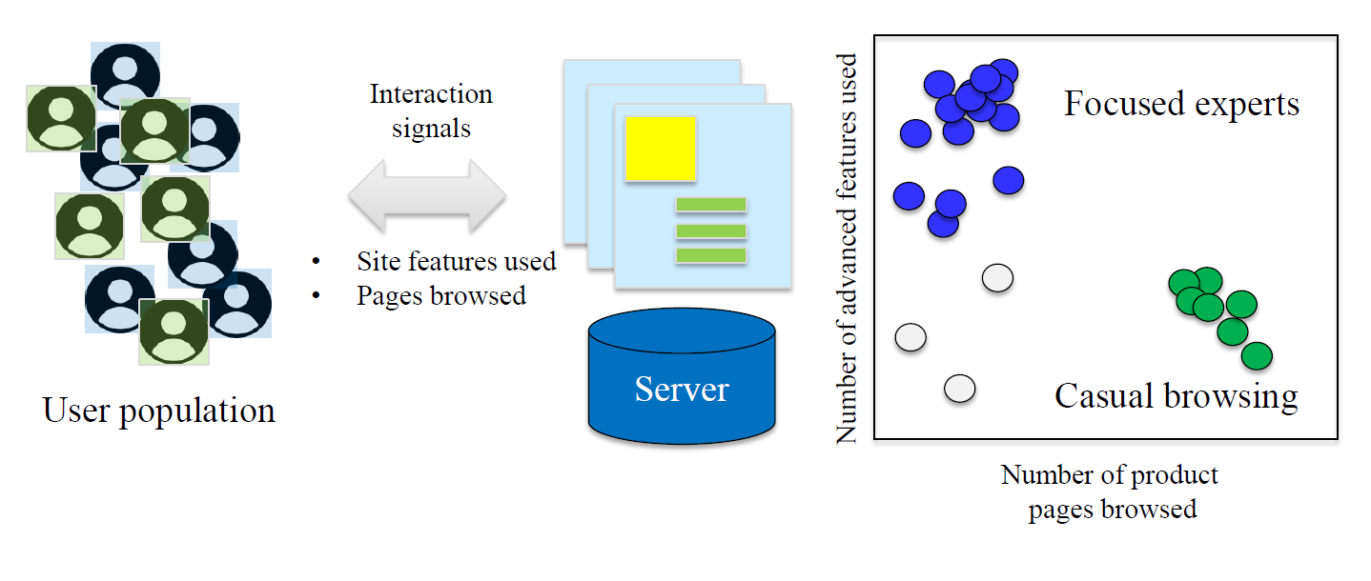
Web Clustering Example

Slide 4
Two major types of unsupervised learning methods
Transformations
Processes that extract or compute information
Clustering
Find groups in the data
Assign every point in the dataset to one of the groups

Slide 5
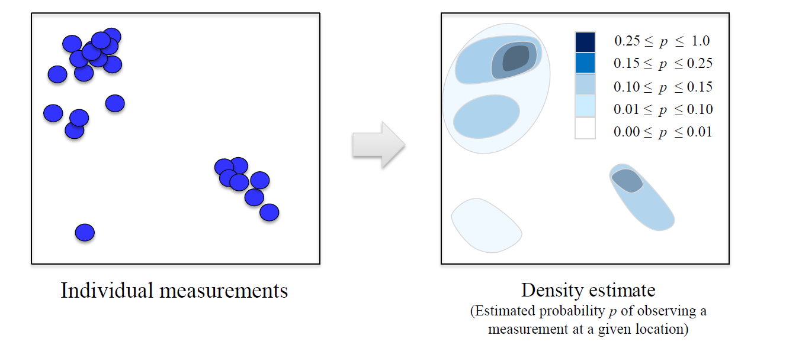
Transformations: Density Estimation

Slide 6
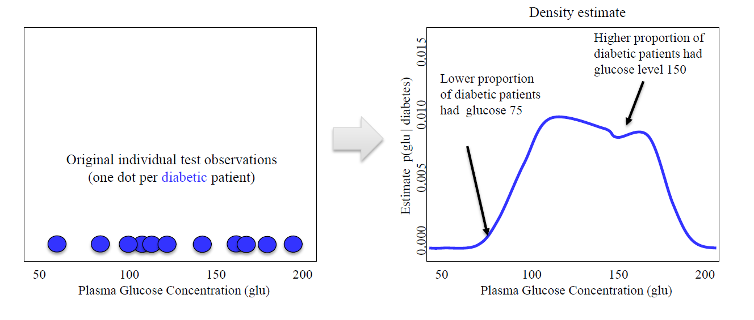
Density Estimation Example

Slide 7
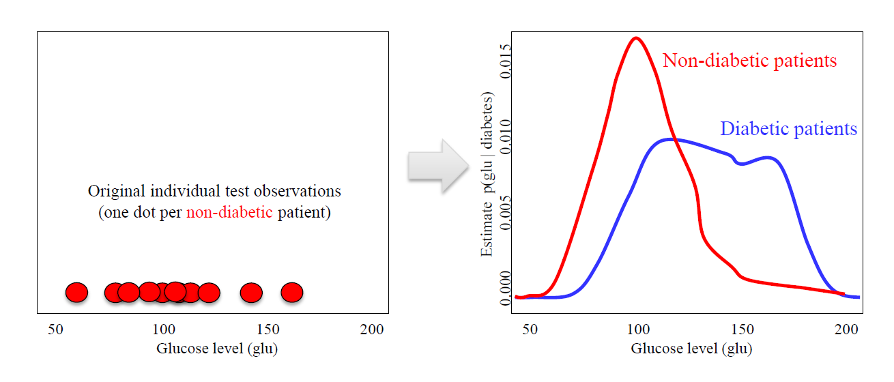
Density Estimation Example

Slide 8
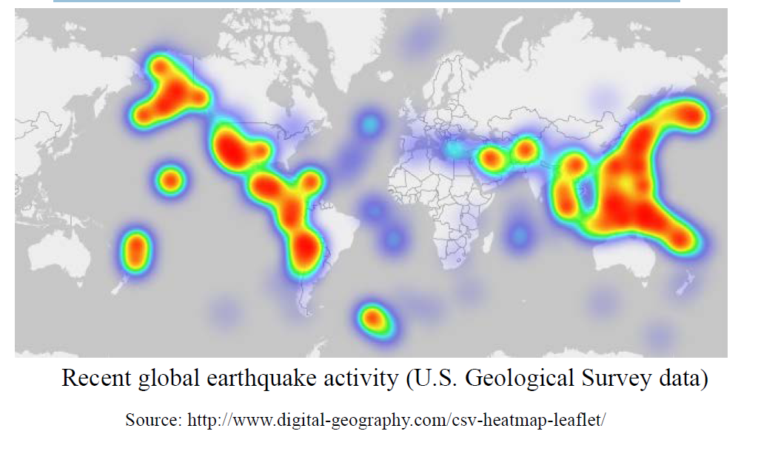
Kernel Density Example

Slide 9
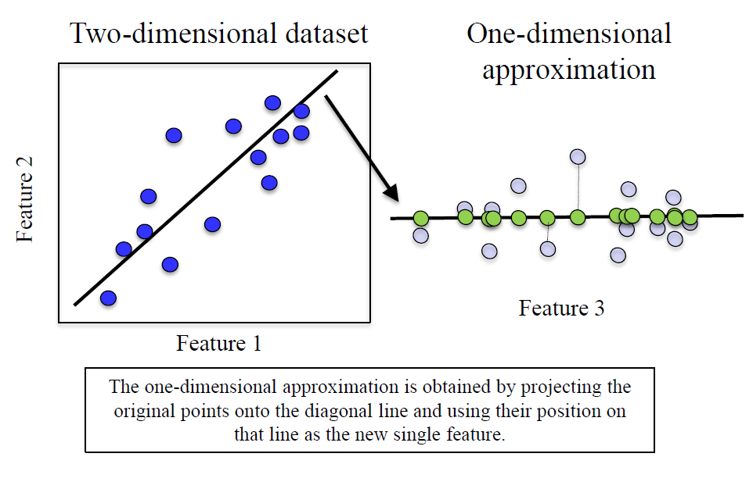
Dimensionality Reduction
Finds an approximate version of your dataset using fewer features
Used for exploring and visualizing a dataset to understand grouping or relationships
Often visualized using a 2-dimensional scatterplot
Also used for compression, finding features for supervised learning

Slide 10
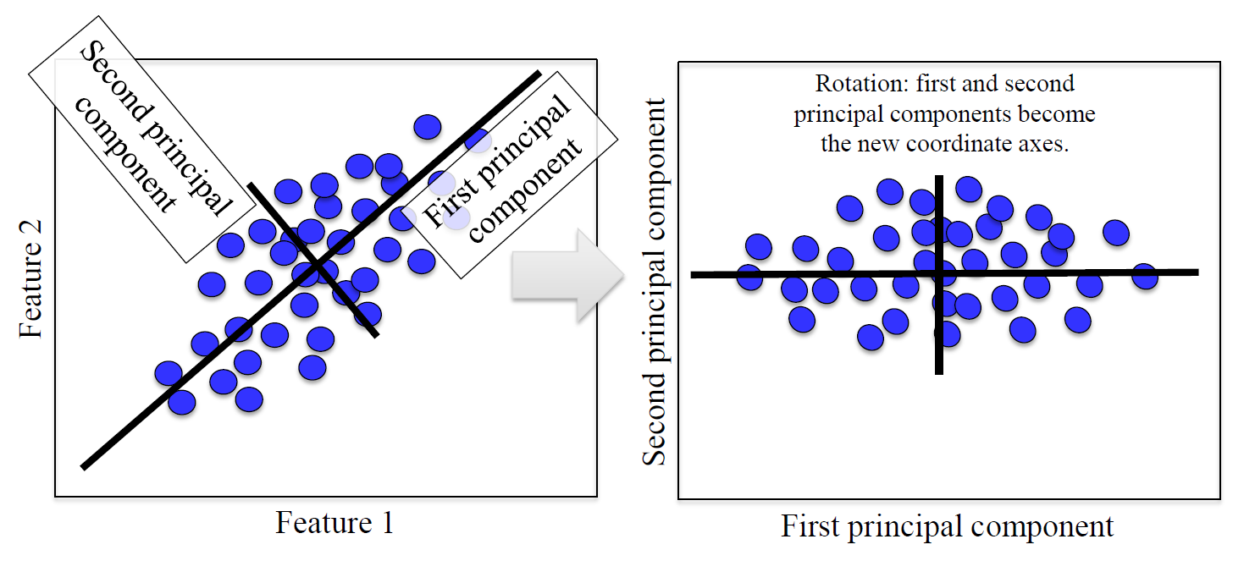
Simple PCA Example

Slide 11
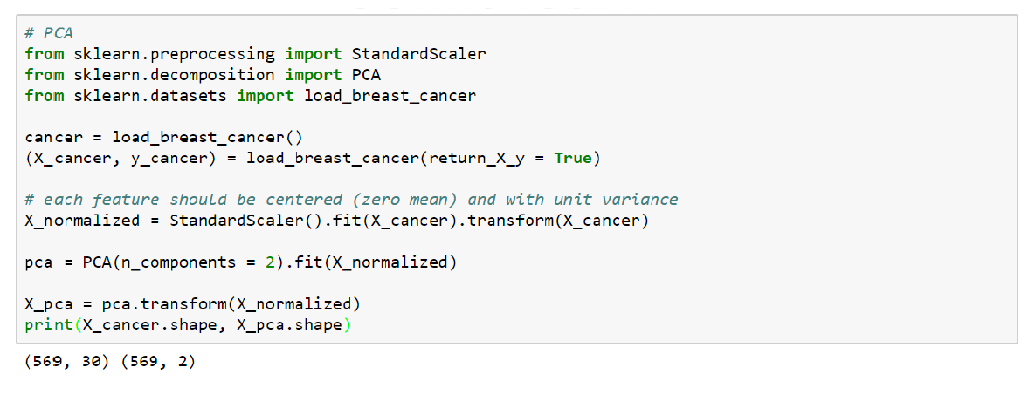
Dimensionality Reduction with PCA in scikit-learn

Slide 12
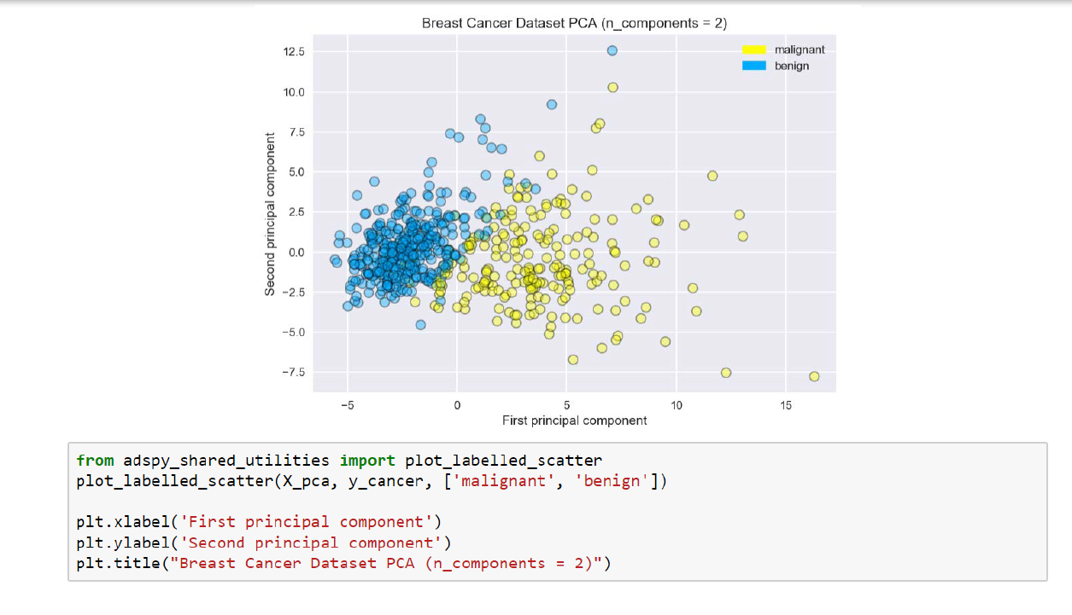

Slide 13
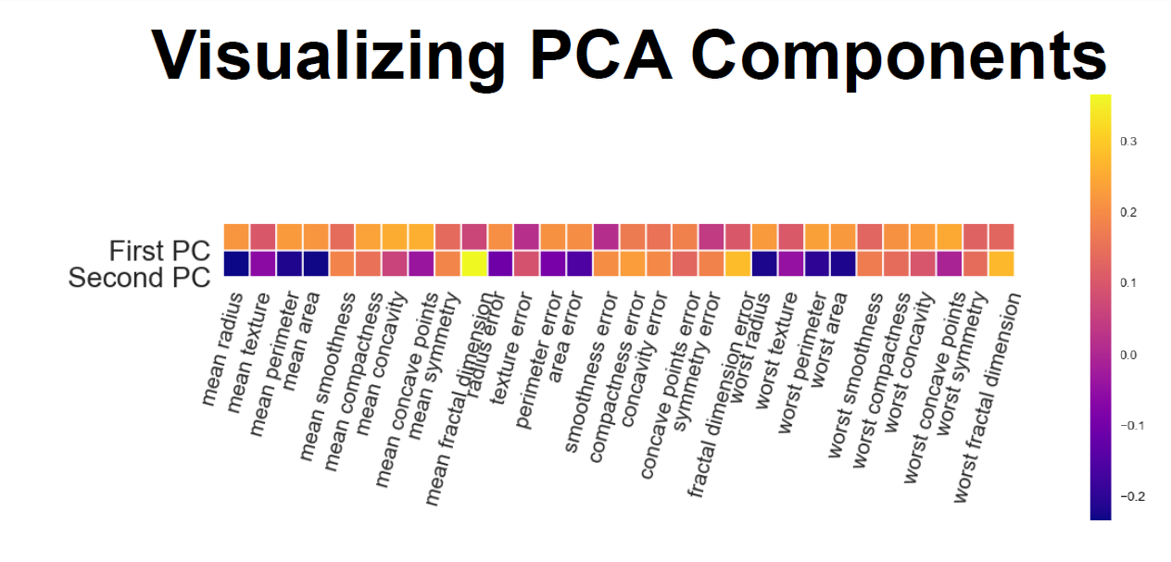

Slide 14
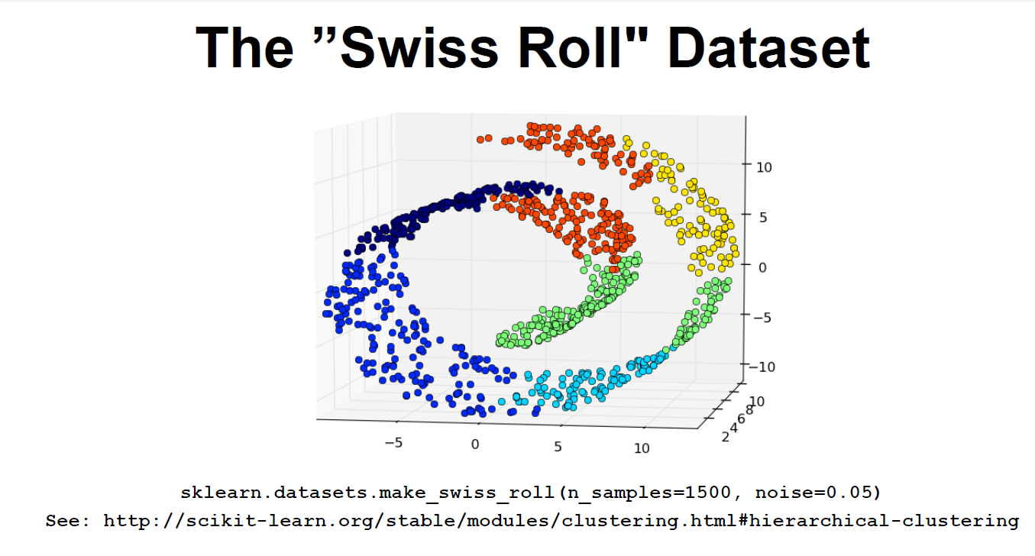

Slide 15
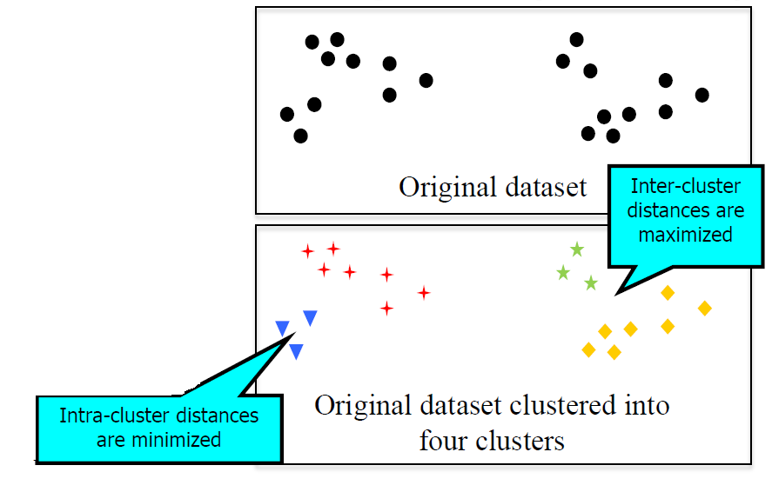
Clustering:Finding a way to divide a dataset into groups ('clusters')
Data points within the same cluster should be 'close' or 'similar' in some way.
Data points in different clusters should be 'far apart' or 'different'
Clustering algorithms output a cluster membership index for each data point:
Hard clustering: each data point belongs to exactly one cluster
Soft (or fuzzy) clustering: each data point is assigned a weight, score or probability of membership for each cluster

Slide 16
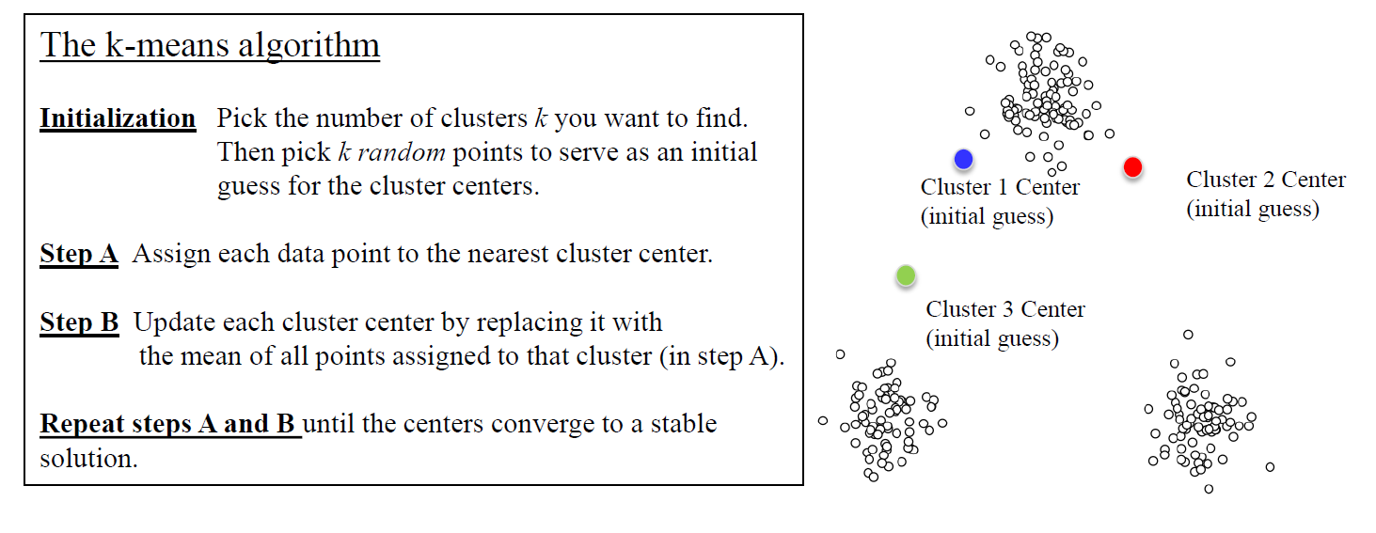
K-means Clustering
Demo: https://www.naftaliharris.com/blog/visualizing-k-means-clustering/

Slide 17
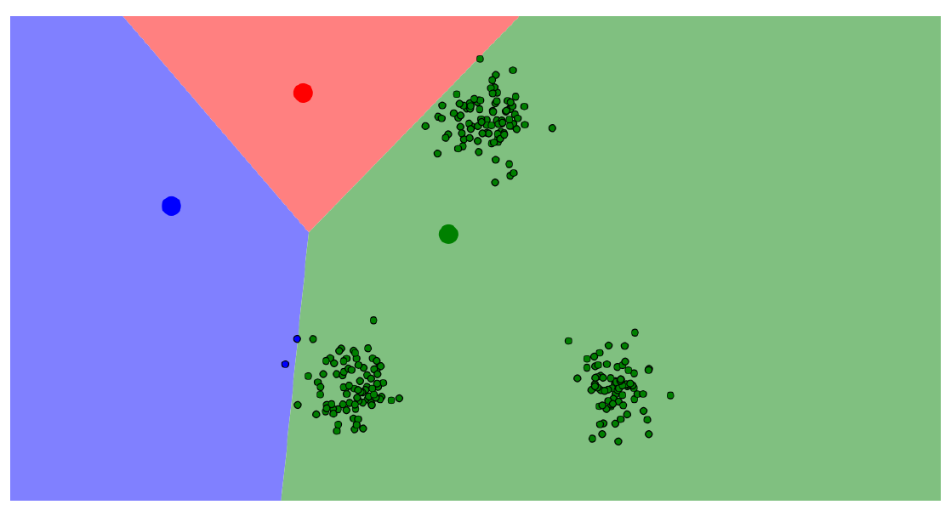
K-means Example: Step 1A
We want three clusters, so three centers are chosen randomly.
Data points are colored according to the closest center.

Slide 18
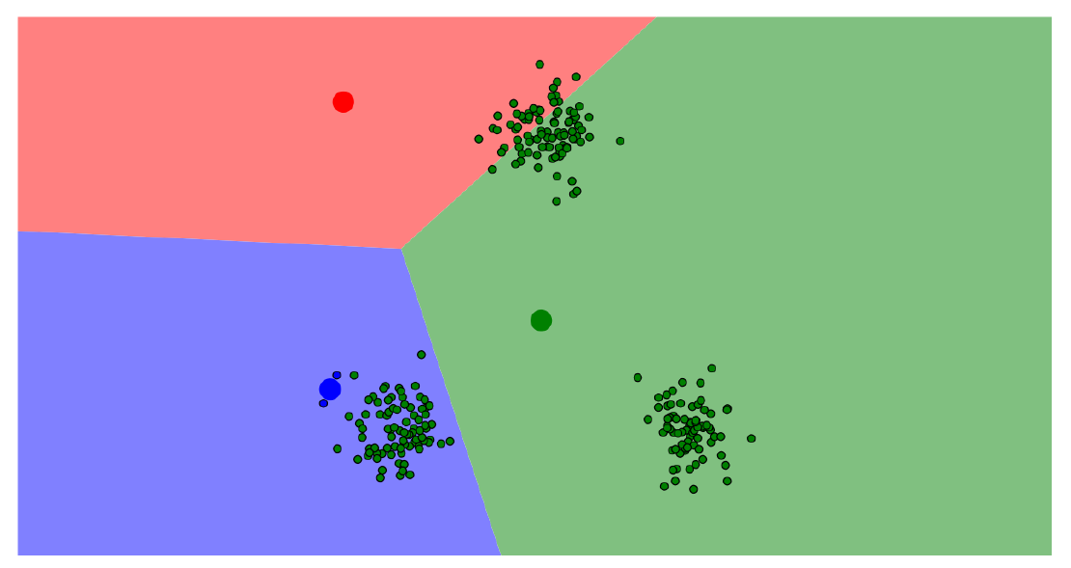
K-means Example: Step 1B
Each center is then updated…
… using the mean of all points assigned to that cluster.

Slide 19
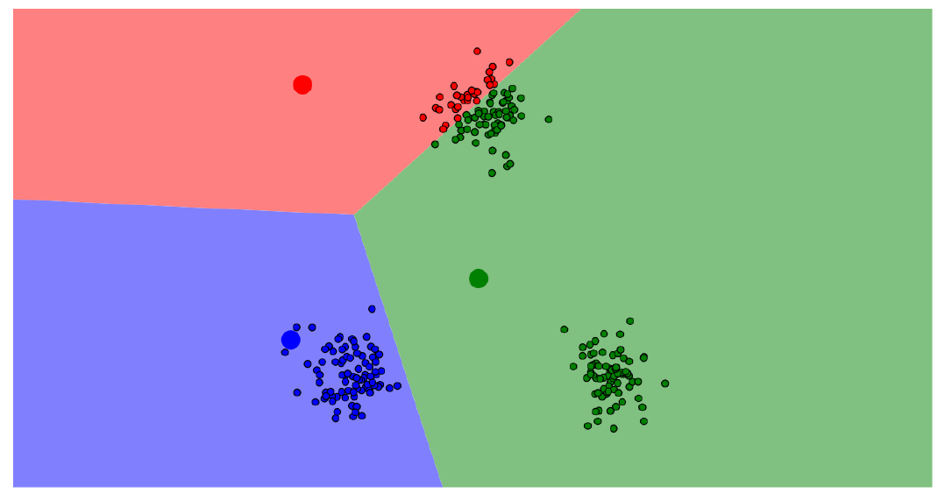
K-means Example: Step 2A
Data points are colored (again) according to the closest center.

Slide 20
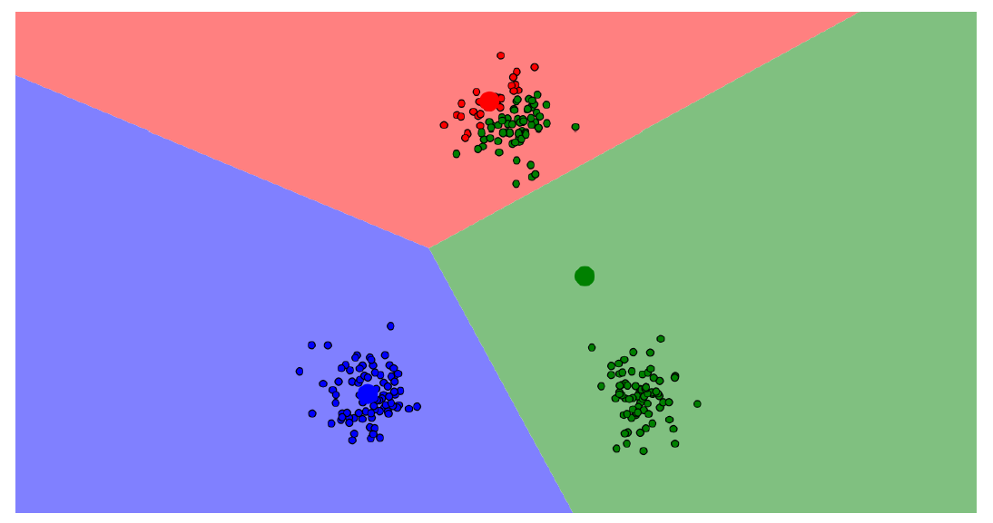
K-means Example: Step 2B
Re-calculate all cluster centers.

Slide 21
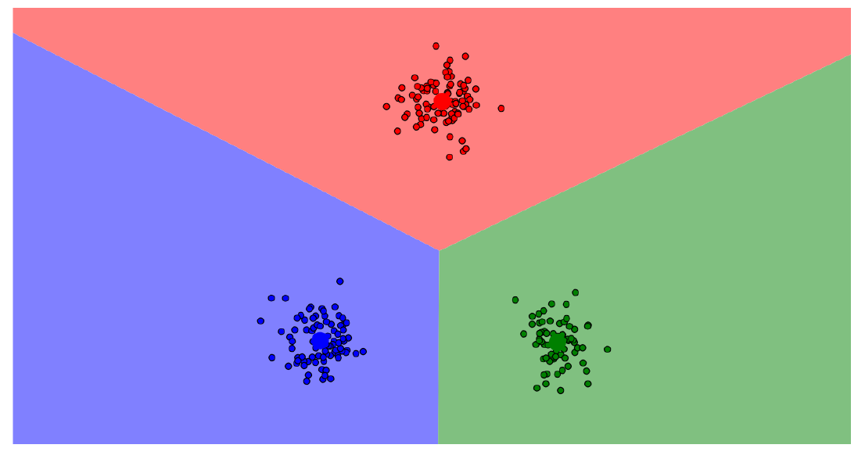
K-means Example: Converged
After repeating these steps for several more iterations…The centers converge to a stable solution!
These centers define the final clusters.

Slide 22
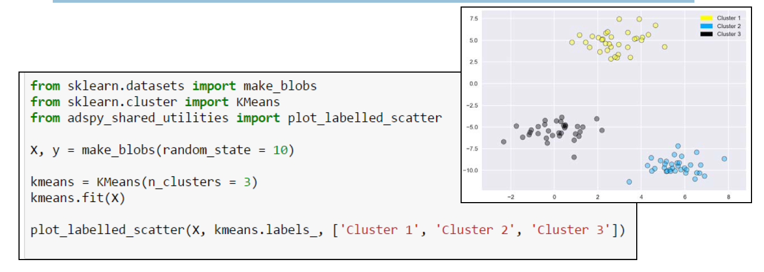
k-means Example in Scikit-Learn

Slide 23
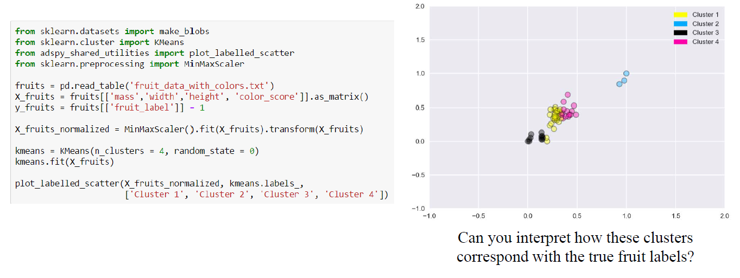
k-means Output on the Fruits Dataset

Slide 24
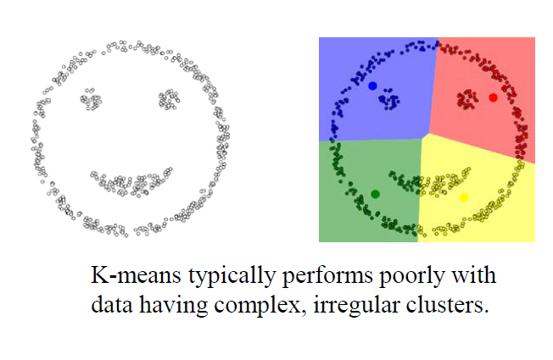
Limitations of k-means
Works well for simple clusters that are same size, well-separated, globular shapes.
Does not do well with irregular, complex clusters.
Variants of k-means like k-medoids can work with categorical features.

Slide 25
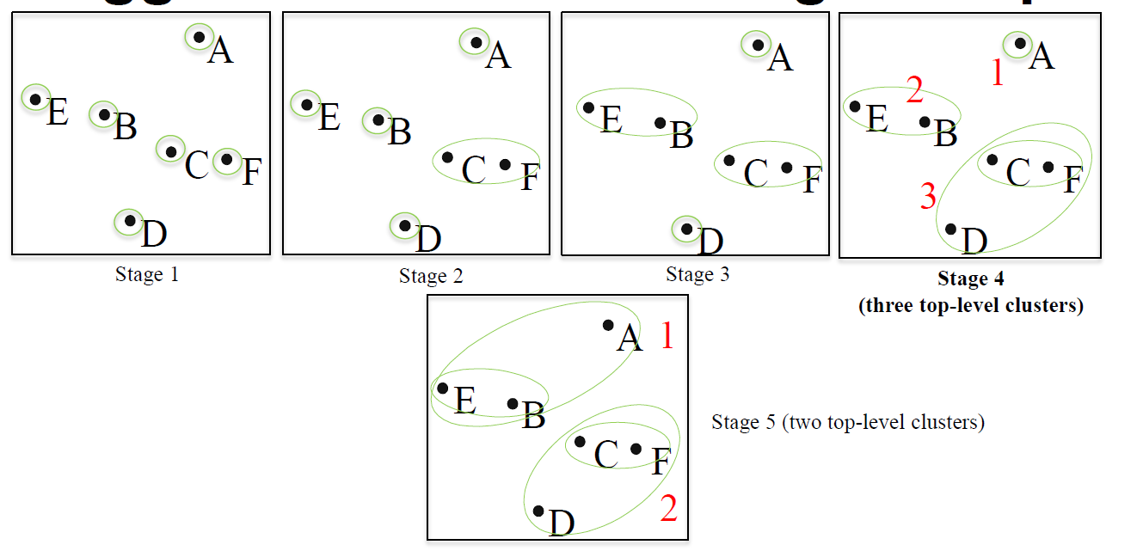
Agglomerative Clustering Example

Slide 26
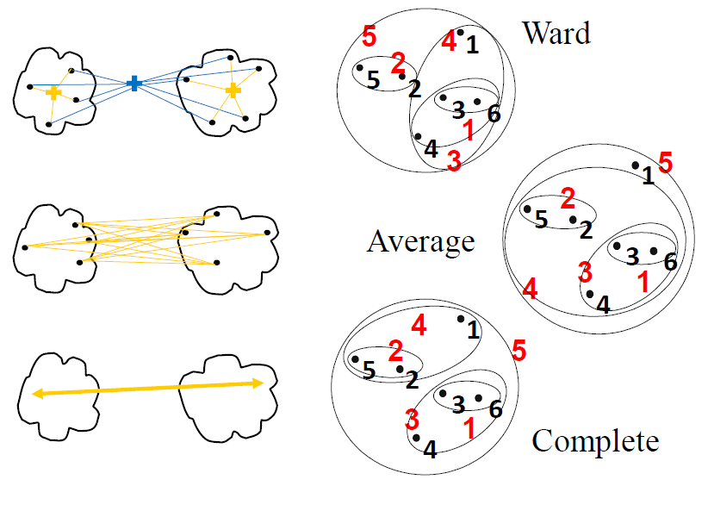
Linkage Criteria for Agglomerative Clustering
Ward's method
Least increase in total variance (around cluster centroids)
Average linkage
Average distance between clusters
Complete linkage
Max distance between clusters

Slide 27
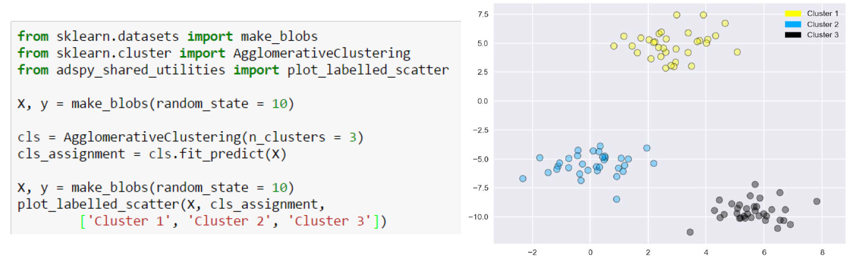
Agglomerative Clustering in Scikit-Learn

Slide 28
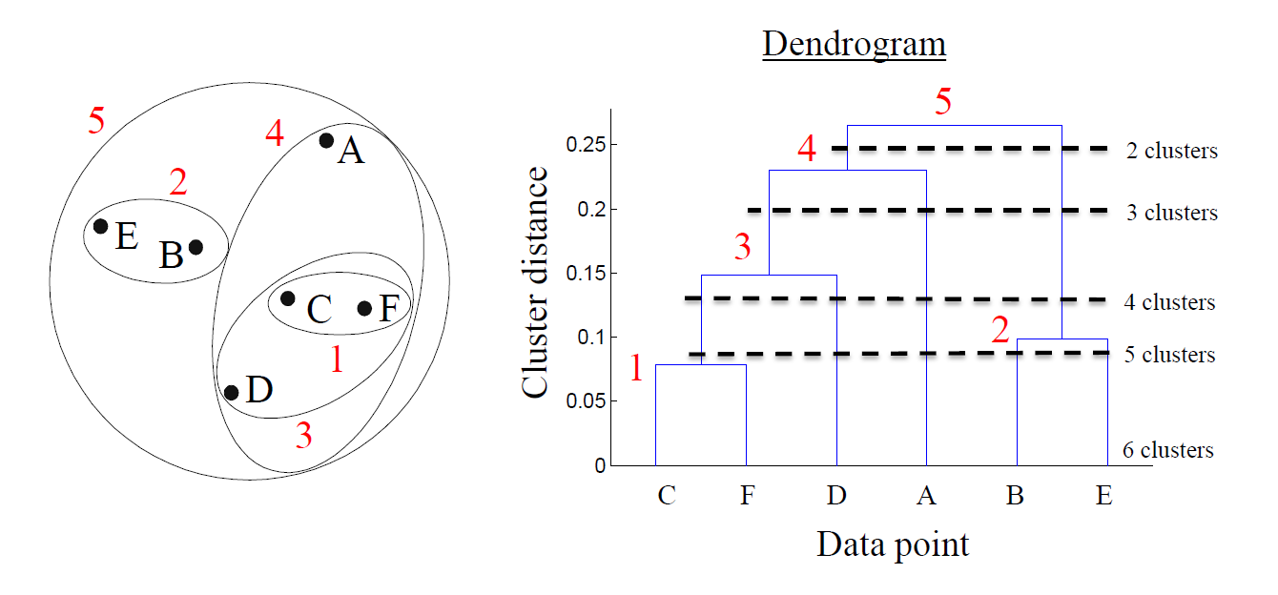
Hierarchical Clustering

Slide 29
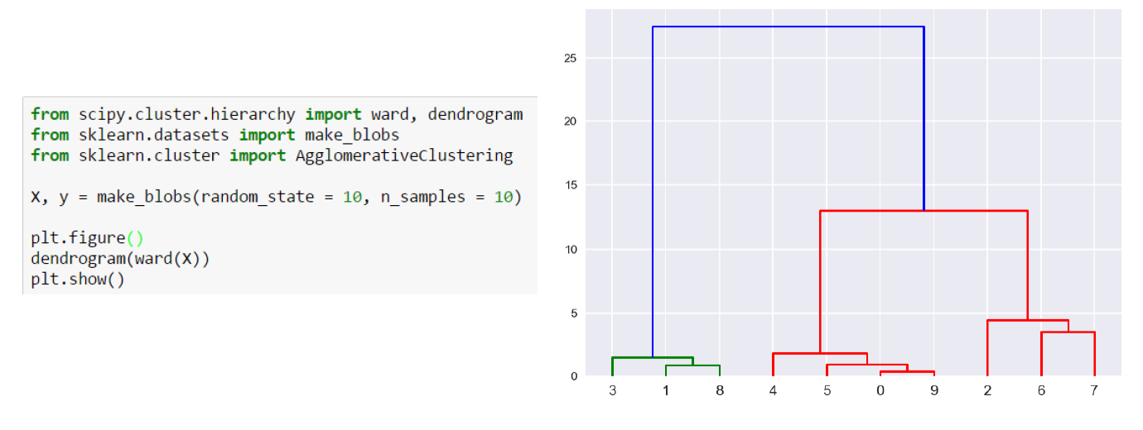
Dendrogram Example

Slide 30
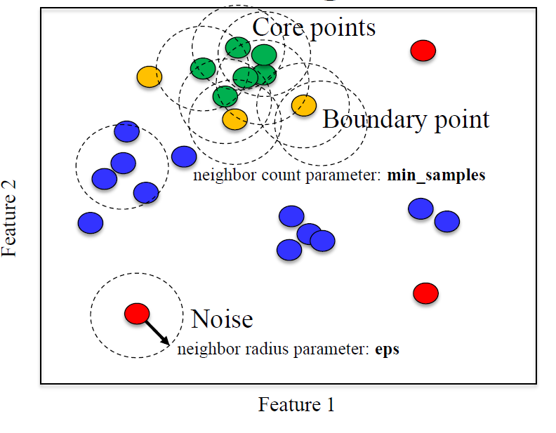
DBSCAN Clustering
Unlike k-means, you don't need to specify # of clusters
Relatively efficient – can be used with large datasets
Identifies likely noise points

Slide 31
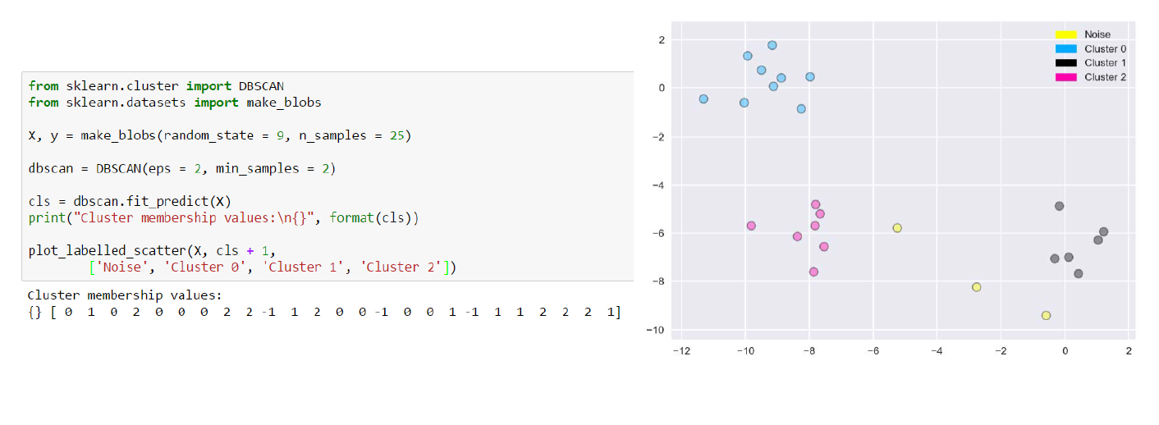
DBSCAN Example in Scikit-Learn

Slide 32
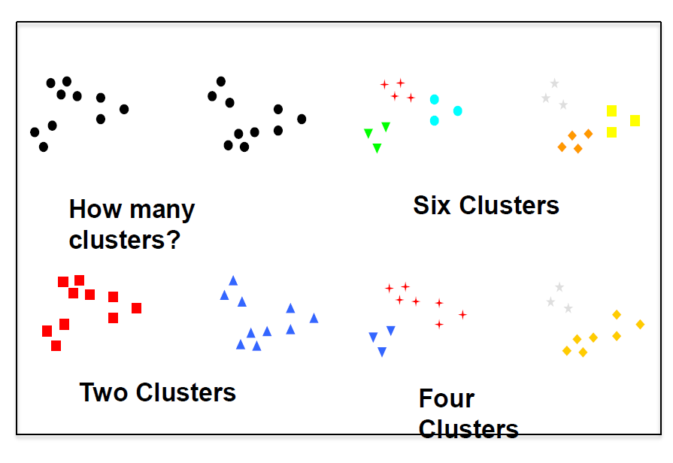
Clustering Evaluation
With ground truth, existing labels can be used to evaluate cluster quality.
Without ground truth, evaluation can difficult: multiple clusterings may be plausible for a dataset.
Consider task-based evaluation: Evaluate clustering according to performance on a task that does have an objective basis for comparison.
Example: the effectiveness of clustering-based features for a supervised learning task.
Some evaluation heuristics exist (e.g. silhouette) but these can be unreliable.

